Slide 1
Case: Root cause analysis for failed to plan deliveries
- Pranshu Srivastava

Slide 2
Context and Scope
Identify the supply chain steps that resulted in failed planned deliveries
Consider special case of Belgium that has more failure rate with respect to other countries
Identify the root cause that can explain the reason for the steps not meeting their deadlines
Assumptions:
a. The deadlines mentioned in the dataset for each step is expected time period between the completion of this step and the previous step.
b. Expected pickup time for an order (different from the time when order is ready) is datetime_ordered + deadline_source + deadline_make. It is also different across different facilities.
c. The actual pickup datetime of an order is equal to the expected pickup time when make step is finished before expected pickup time else it is 24 hours + expected pickup time for a given facility.
d. If the order failed to delivered as planned and steps from make to delivery met the deadlines then plan step is at fault.
e. Country in the data set is country of origin of the order i.e. the order is placed from this country and delivery will be made in this country.

Slide 3
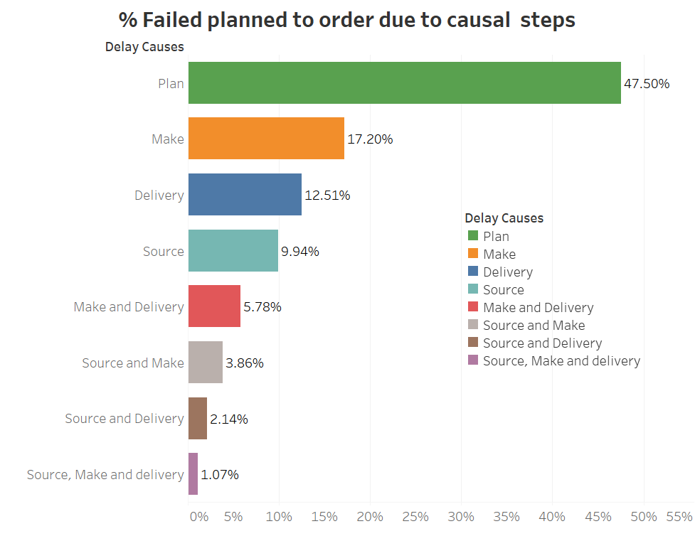
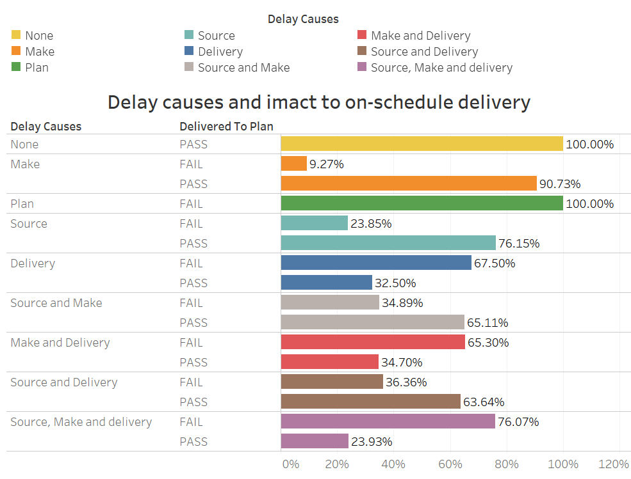
Context and Scope - Identification (Descriptive analytics)
Find the major supply chain steps that might have caused large percentage failed planned to delivery.
Check relative performance of pass and failed planned delivery with respect to delay cause i.e. steps not meeting deadlines.

Slide 4

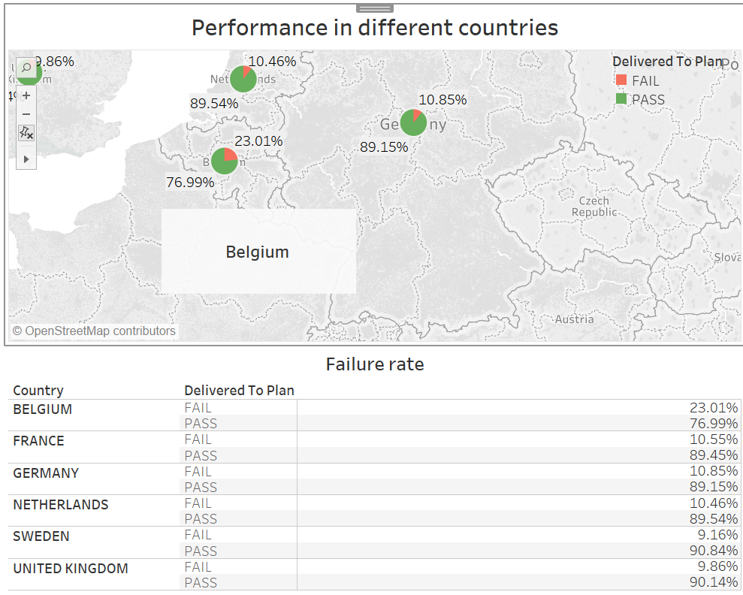
Context and Scope - Identification (Descriptive analytics)
Consider the special case of Belgium that has high failure rate with respect to other countries.

Slide 5
Approach and Methodology
Perform feature engineering to create important features such as is_source_delay, is_make_delay, is_delivery_delay and is_plan_delay (bad plan)
1
Use variable importance analysis using decision trees and random forest to identify the most important variables that can explain failed planned delivery orders.
2
Build the Bayesian network model to identify the relationship between various variables and find the root/roots.
3
Use the understanding from descriptive analysis, variable importance analysis and Bayesian Network to explain the cause of failed planned deliveries
4

Slide 6
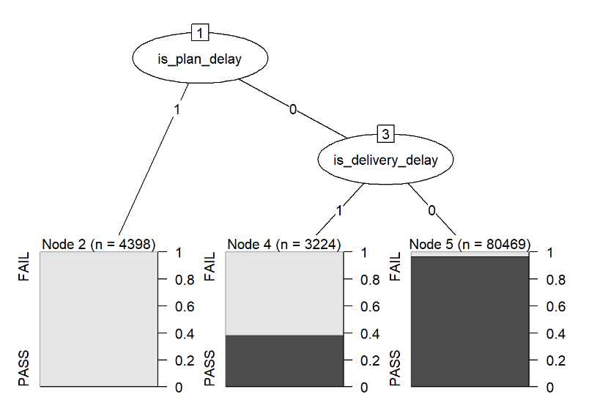
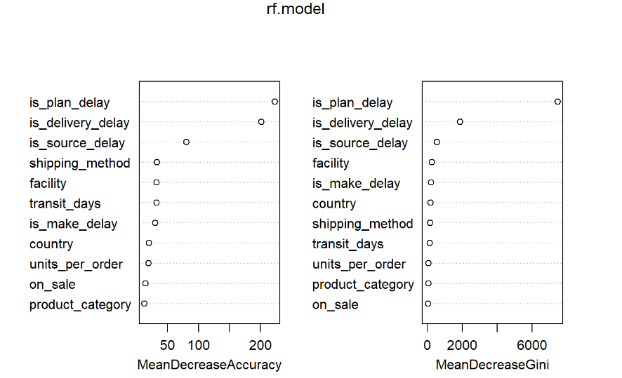
Approach and Methodologies – Variable Importance
From these two graphs we can interpret that bad plan and delay in delivery are two most important variables that explains failed planned deliveries

Slide 7
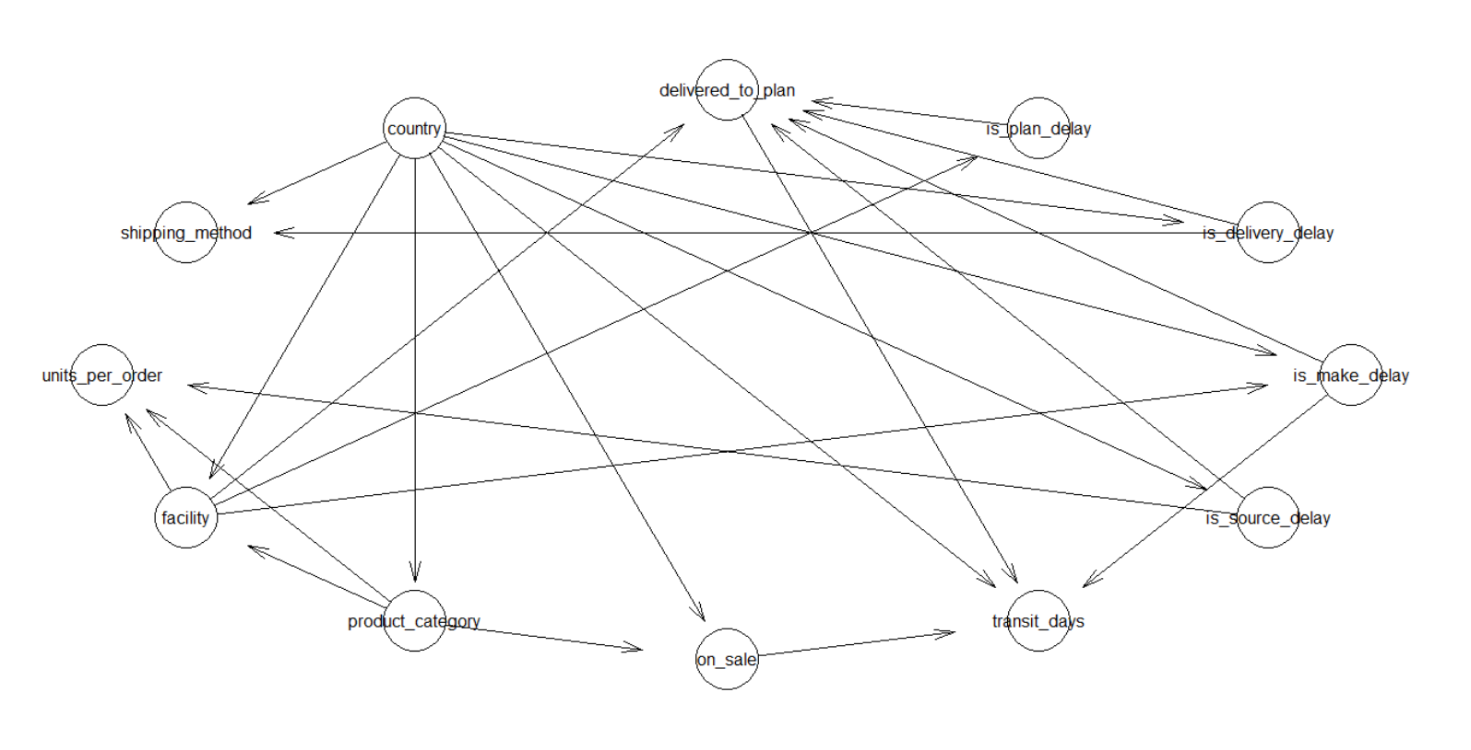
Approach and Methodologies – Bayesian Network Graph
From the above network diagram we can see that country is the root node.
Country and facility are two major nodes that are affecting delays.
Facility is conditional upon country and product category

Slide 8
Results
Bad plan is the major factor in the failed planned deliveries
Delay in delivery is another important factor for failed planned deliveries
For Belgium delivery step does not meets its deadline that results in failed planned deliveries. Belgium is served by Eindhoven which is a facility in Netherlands even when Antwerp is present within Belgium. Belgium should be served from Antwerp.
Bayesian network suggests that country effects delay in source and delivery steps.
Facility affects delay in plan and make. Facility itself is affected by country and product categories.
Conclusion: The planning process is at fault. It does not map the right facility for the right product category to the correct order generating country. Delays in the delivery can also be the fault of bad planning that does not provide correct allocation of order to correct facility so that delivery time is optimized.

Slide 9
Adoption Plan
To correct the planning process the company has to map which country can be served in the optimized way with what facility. This will reduce the delivery delays.
The company through control experiments and further statistical analysis can come up with the ways to improve its planning process.
They should create experiments to map the orders generated in the country to the facility within the country and/or the facilities nearby.
They can then use the experiment’s data to check which facility, product category and country combination provide significant improvement in delay deliveries and is this improvement statistically significant.

Slide 10
Thank You

